Slide 1
Preparing For Your
DPS Journey
Part II
DPS Academic team
November 2023
Peter Do SS19

Slide 2
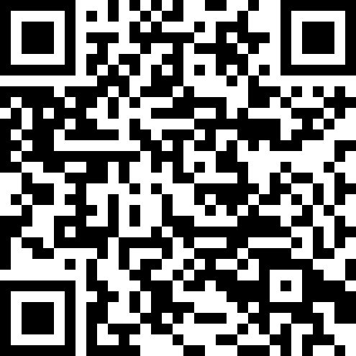
REGISTER
Please scan the QR code to add your name to the register on Moodle.
If it doesn’t work please sign manual register by door.
Thanks!
Notes:
To avoid overloading the slides with text, use speaker notes to add more detail and prompts.

Slide 3
Participants consent to collect activity mind maps
Conducting Academic Teaching Research.
Your participation in two of our activities in this session gives consent for the information collected from the activity to be used as part of a research study.
The research study is about the DPS programme, students experience, aspirations and expectations and the data from this session will be used for this study.
Only tutors on the teaching programme will have access to data collected from the activity.

Slide 4
Participant consent to collect activity mind maps
If you give consent for your mind maps to be used, please hand it in after the session. (take a pic if you want to remember what you wrote!)
Please do not add your name to the mind map activities sheets.
If you do not give consent please keep hold of your activity sheet.
If after the session you wish to withdraw your consent and do not want your mind map included in study please email me.

Slide 5
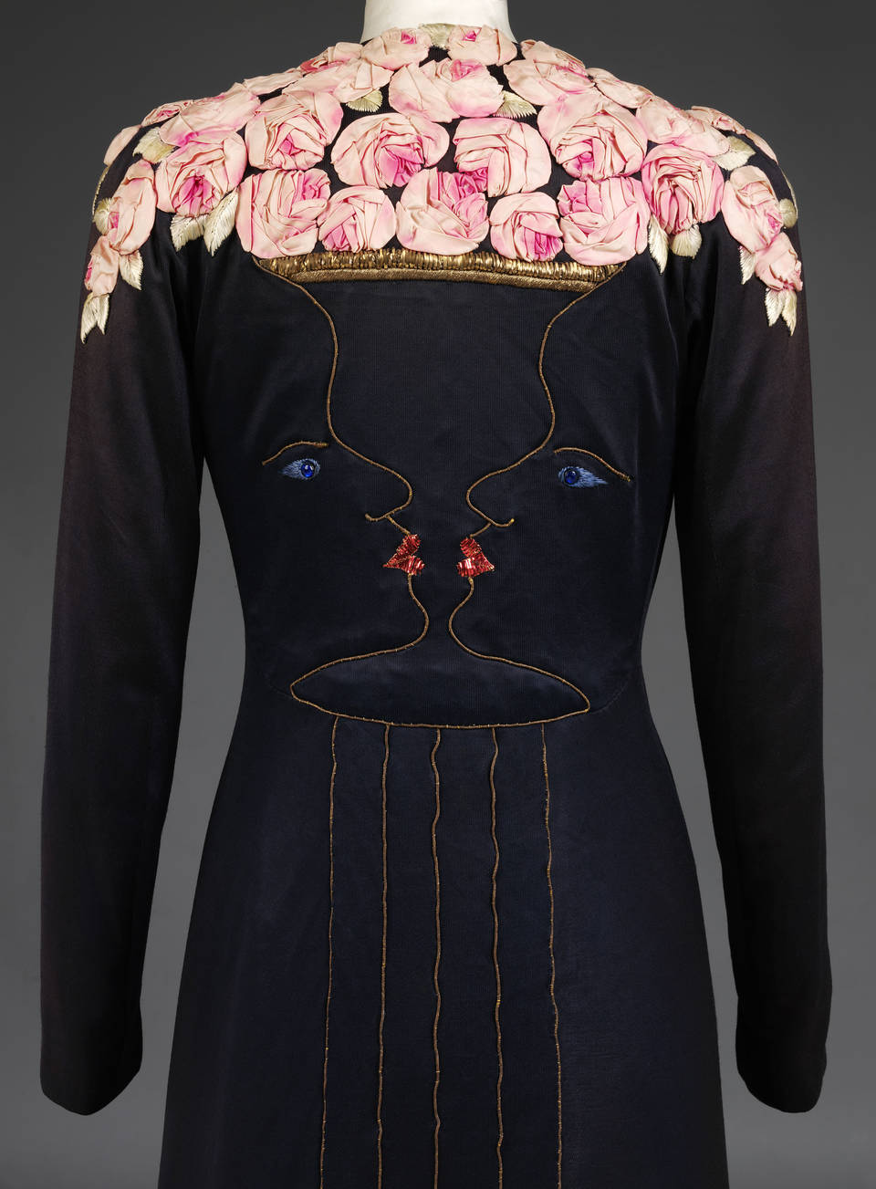
Today’s Session:
Preparing for your placement year:
Your online profile
Mind Map Activity: Brands and Businesses
Creating your own contact list.
Speculative emails –(Opt-in requirement)
Job searching strategies
Portfolio’s
Career support and online resources.
Dior @ V&A
SCHIAPARELLI at the V&A

Slide 6
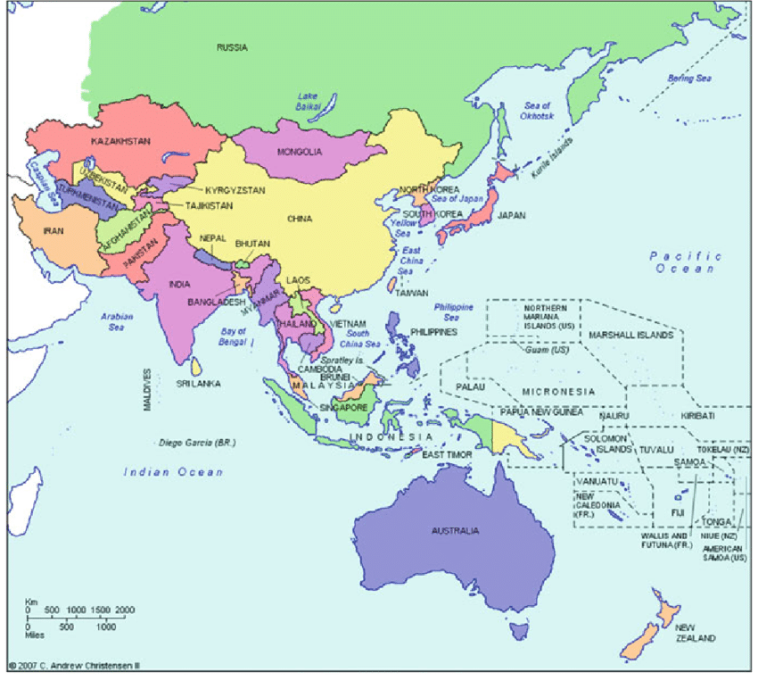
Activity: Global Brands & Businesses
Create a mind map:
In 2 minutes list as many Non European or US brands, businesses, creatives.
Think emergent markets such as South America, Asia Pacific region, Africa,
The Middle east…. Do not use Google!
Non-Euro & US brands & businesses
Map of Asia-Pacific region
Dior @ V&A

Slide 7
Activity: My brands & Businesses
Create your own mind map:
In 2 minutes list as many brands, businesses or creatives you would like to work with during your placement year.
Write on the map where they are located geographically.
My ideal placement brands & businesses & Where
Dior @ V&A

